Slide 1
Preparing for an Interview
Notes:
Developers: Please edit the audio on any slide that needs it. There are a few stumbles that need to be removed. Thanks.

Slide 2
Preparing for an Interview
You get only one chance to make a good first impression
Research the company
#1 complaint of employers
Review the job description
Create a list of your skills and abilities
Prepare 1- to 2-minute commercial about yourself
Notes:
End Audio after“why you would want to work for the company”. Time accordingly

Slide 3
Preparing to Answer Questions
Be ready to answer basic and behavioral interview questions and discuss
Your major
Previous job experience
Goals and career plans
Strengths and weaknesses
Give specific examples and generalities
Be prepared with at least five scenarios that demonstrate your skills
Notes:
Start audio with “Be sure to prepare….” edit audio and time bullets accordingly

Slide 4
Preparing for an Interview
Be able to articulate what you have to offer the company
Prepare 3-5 questions to ask the interviewer
Research salaries; contact references
Plan for professional attire
“What are the challenges of this position?”
“What kind of training is involved?”
“I learned XYZ company …”
Notes:
Have image come in with second bullet then have each question come in when she talks about them. They can all fade out when the third bullet comes in.

Slide 5
Do You Look Professional?
All candidates should dress professionally
Quality suit in dark neutral color (avoid linen)
Light jewelry
Minimal cologne, perfume, or after shave
Classic trench coat
Cover visible tattoos and piercings
No smoking, gum chewing
Notes:
No timing is necessary. Please edit audio if you can where she messes up.
How well you interview determines whether or not you advance in the hiring process. With enough preparation and practice, you can improve your interviewing skills and effectiveness.

Slide 6
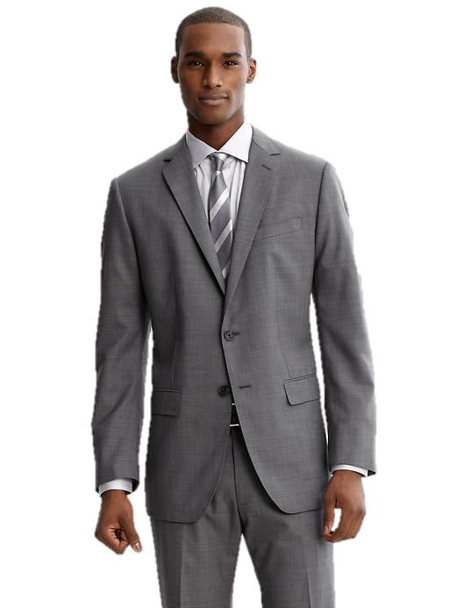
Do You Look Professional?
Male Candidates
Solid white/pastel dress shirt
Conservative tie
Dark, polished leather shoes
Dark calf-length socks
Neatly trimmed facial hair
Female Candidates
Tailored shirt or shell in light color
Polished closed-toed shoes
Neutral colored hose
Conservative make-up
Conservative hair style; long hair pulled back
Notes:
No timing needed. Leave this slide up for a few seconds after the audio so the students have time to look at it, maybe a few seconds of silence before the audio starts and a few seconds after (no more then 5)
How well you interview determines whether or not you advance in the hiring process. With enough preparation and practice, you can improve your interviewing skills and effectiveness.

Slide 7
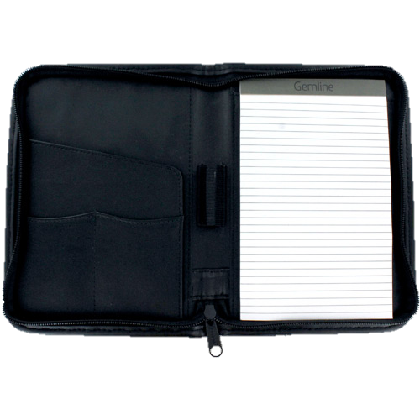
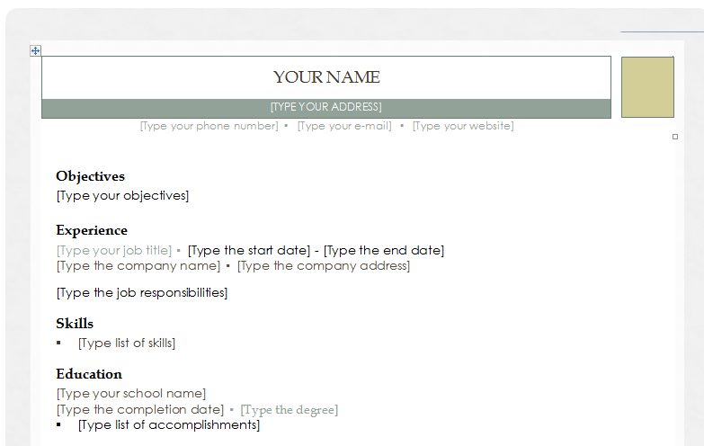
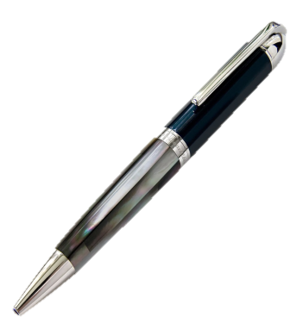
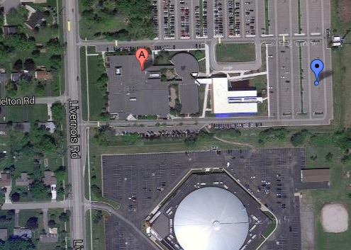
The Day of the Interview
Carry these items to the interview:
Pad folio with paper and pen for notes
Several copies of resume on quality paper
Separate copy of references, copy of transcripts
Directions for interview site
Notes:
Time bullets accordingly
Make eye contact – don’t look down or away form the employer when speaking with them.
Check your attire one last time in the restroom before the interview.
Ask the employer about his/her position and how they got into the filed, etc. – it shows interest and builds rapport.

Slide 8
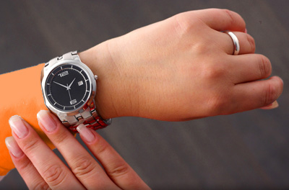
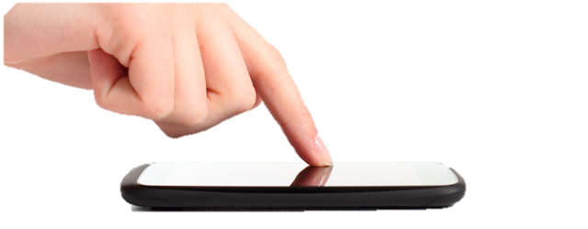
The Day of the Interview
Arrive 10-15 minutes early
Make sure cellphone is OFF
First impressions are lasting impressions so be sure to make it a great one!
Introduce yourself to the receptionist
Greet interviewer by name; shake hands firmly and smile
Notes:
Please time accordingly
Bring:
a padfolio
extra copies of your resume—printed on resume quality paper
separate copy of your references—at least three professional references
a small notebook with all relevant information you may need to put on an application
paper and a pen (erasable) to take notes
Friendly but formal—don’t be too relaxed and let your guard down.
Information: value building: Show the value that your strengths will bring to the company
Presentation: rapport-building: People hire people they like

